Slide 1

AuraCheck
AI wellbeing tracker

Slide 2
Why AuraCheck?
Background
Problem
According to the 2024–2025 Healthy Minds Study (N = 84,735 students across 135 institutions):
37% of students screen positive for depression
33% screen positive for anxiety
45% meet criteria for either depression or anxiety
16% report that mental health difficulties hurt their academic performance for 6+ days in the past month
These findings indicate a high prevalence of psychological distress and functional impairment among college students.
Despite high level of distress; however, these following problems accompanied:
83% know where to access resources; however, only 21% are currently in therapy; 38% received therapy in the past year.
The majority citing “not enough time” , financial reasons as a barrier, while others prefer to deal with the problem alone.
The gap is not awareness but early detection and engagement

Slide 3
Project Objectives
The purpose of our project is not to replace clinical diagnosis or counseling. We aim to:
Provide a private, self-guided early burnout risk monitor
Enable quick daily check-ins (1–2 minutes)
Detect cumulative psychological strain before it escalates into academic impairment
Serve as a low-friction bridge between self-awareness and formal support

Slide 4
Dataset
Name: Students Mental Health Assessments
Source: Kaggle (Saint)
Data Adjustment:
Additional synthetic samples generated using ChatGPT to expand sample size and improve modeling robustness.
Overview:
The dataset, compiled from multiple anonymous source, contains anonymized evaluations of college students’ mental health and related behavioral, academic, and lifestyle factors. This dataset seeks to provide valuable insights into the mental health of students.
Variables:
Academic Load: Semester_Credit_Load – Number of academic credits (15–30 range)
Social & Environmental Factors:
Social_Support – Perceived social support
Substance_Use – Frequency of alcohol, tobacco, or drug use
Family_History – Family history of mental health conditions
Chronic_Illness – Presence of chronic illness
Financial_Stress – Level of financial stress (0–5 scale)
Lifestyle Factors:
Sleep_Quality – Self-rated sleep quality
Physical_Activity – Level of physical activity
Diet_Quality – Nutritional quality assessment
Psychological Indicators:
Stress_Level – Self-reported stress intensity
Depression_Score – Quantified depression severity
Anxiety_Score – Quantified anxiety severity

Slide 5
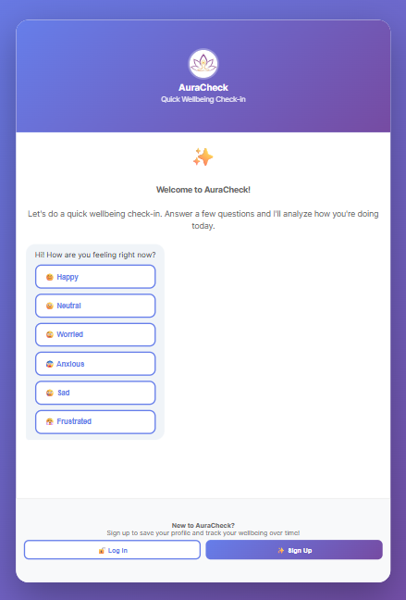


Proposed Product
So what can we do?
Tell
AuraCheck!
A daily AI-powered mental wellbeing monitoring tool for college students that predicts burnout and stress risk using daily check-ins

Slide 6
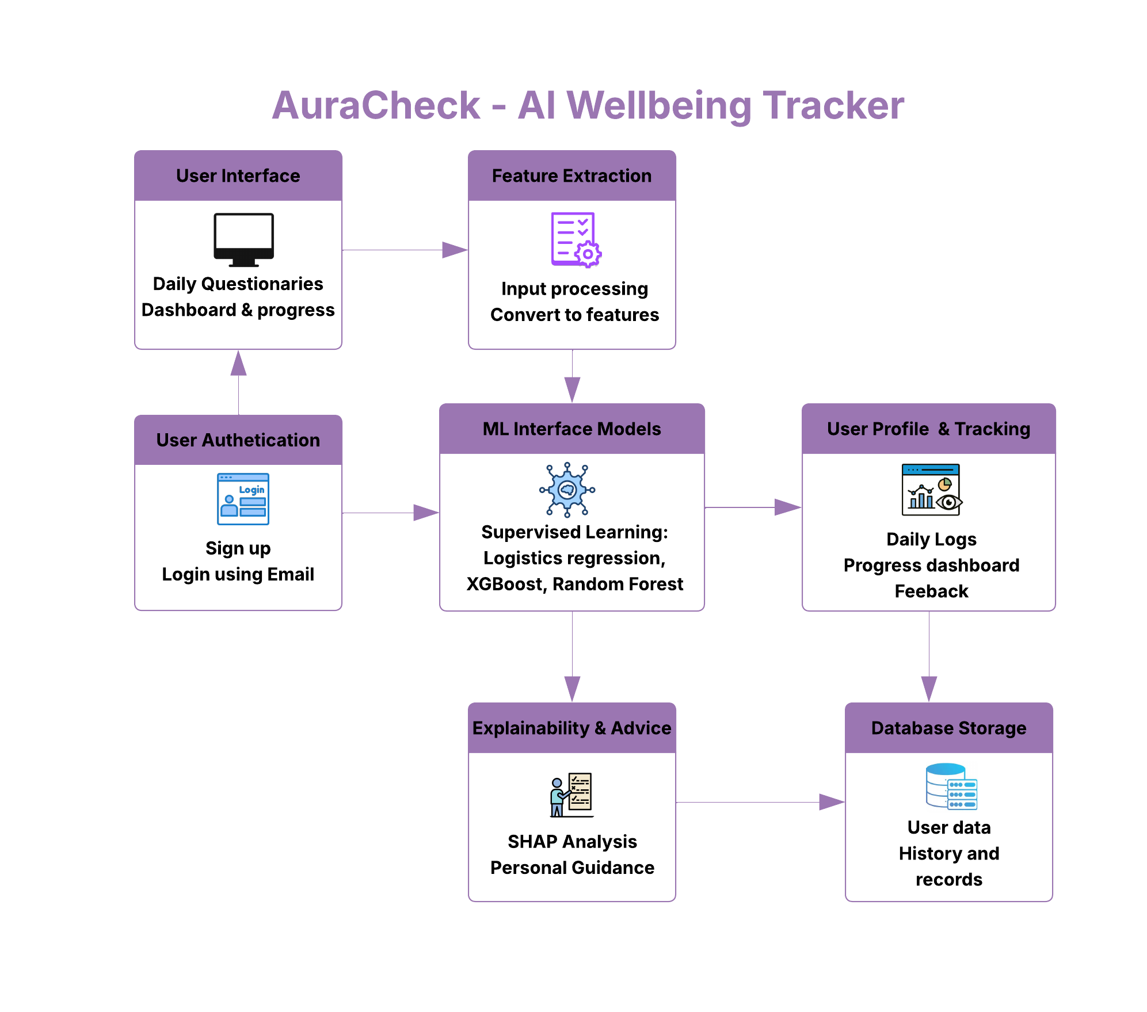
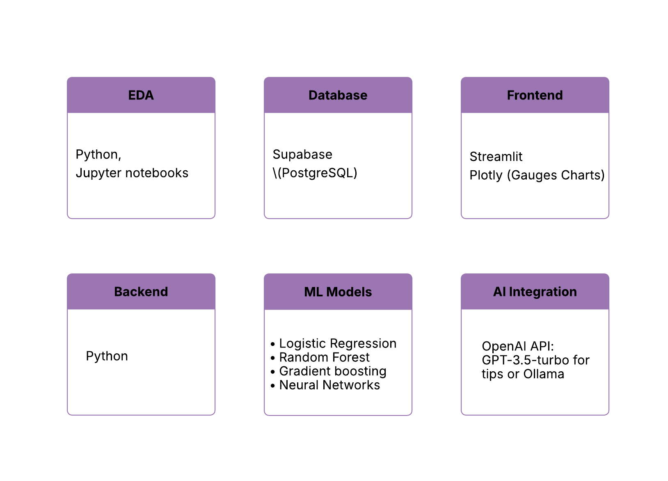
Vision & Proposed Techstack

Slide 7
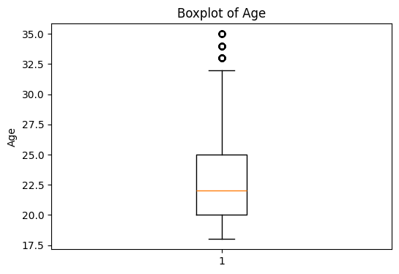
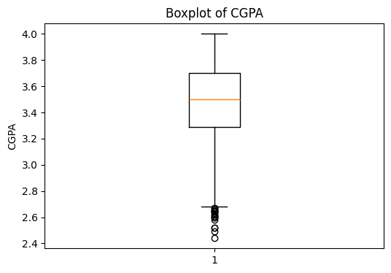
EDA
Since we imputed 3,000 rows, we made sure our descriptive statistics didn’t change (they didn’t).
We created either histograms or boxplots to see distributions of responses
Have a few outliers in terms of age and CGPA (higher age and lower CGPA). Should probably keep outliers.

Slide 8
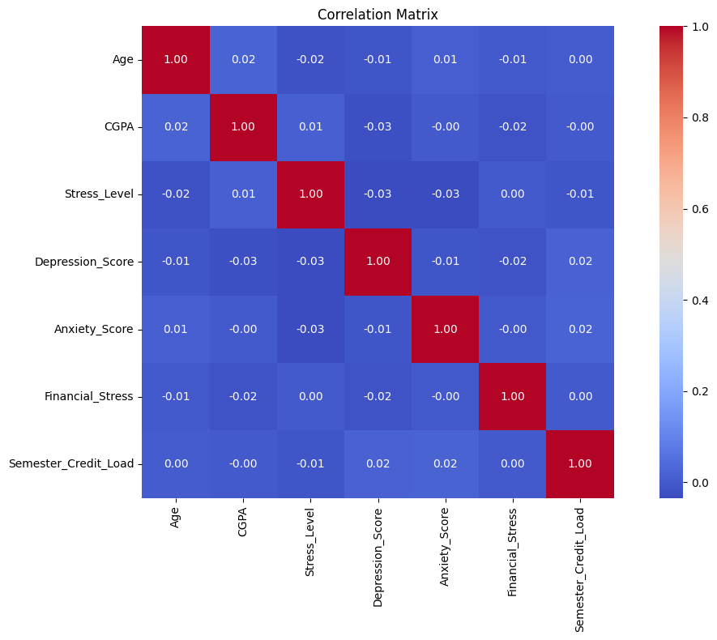
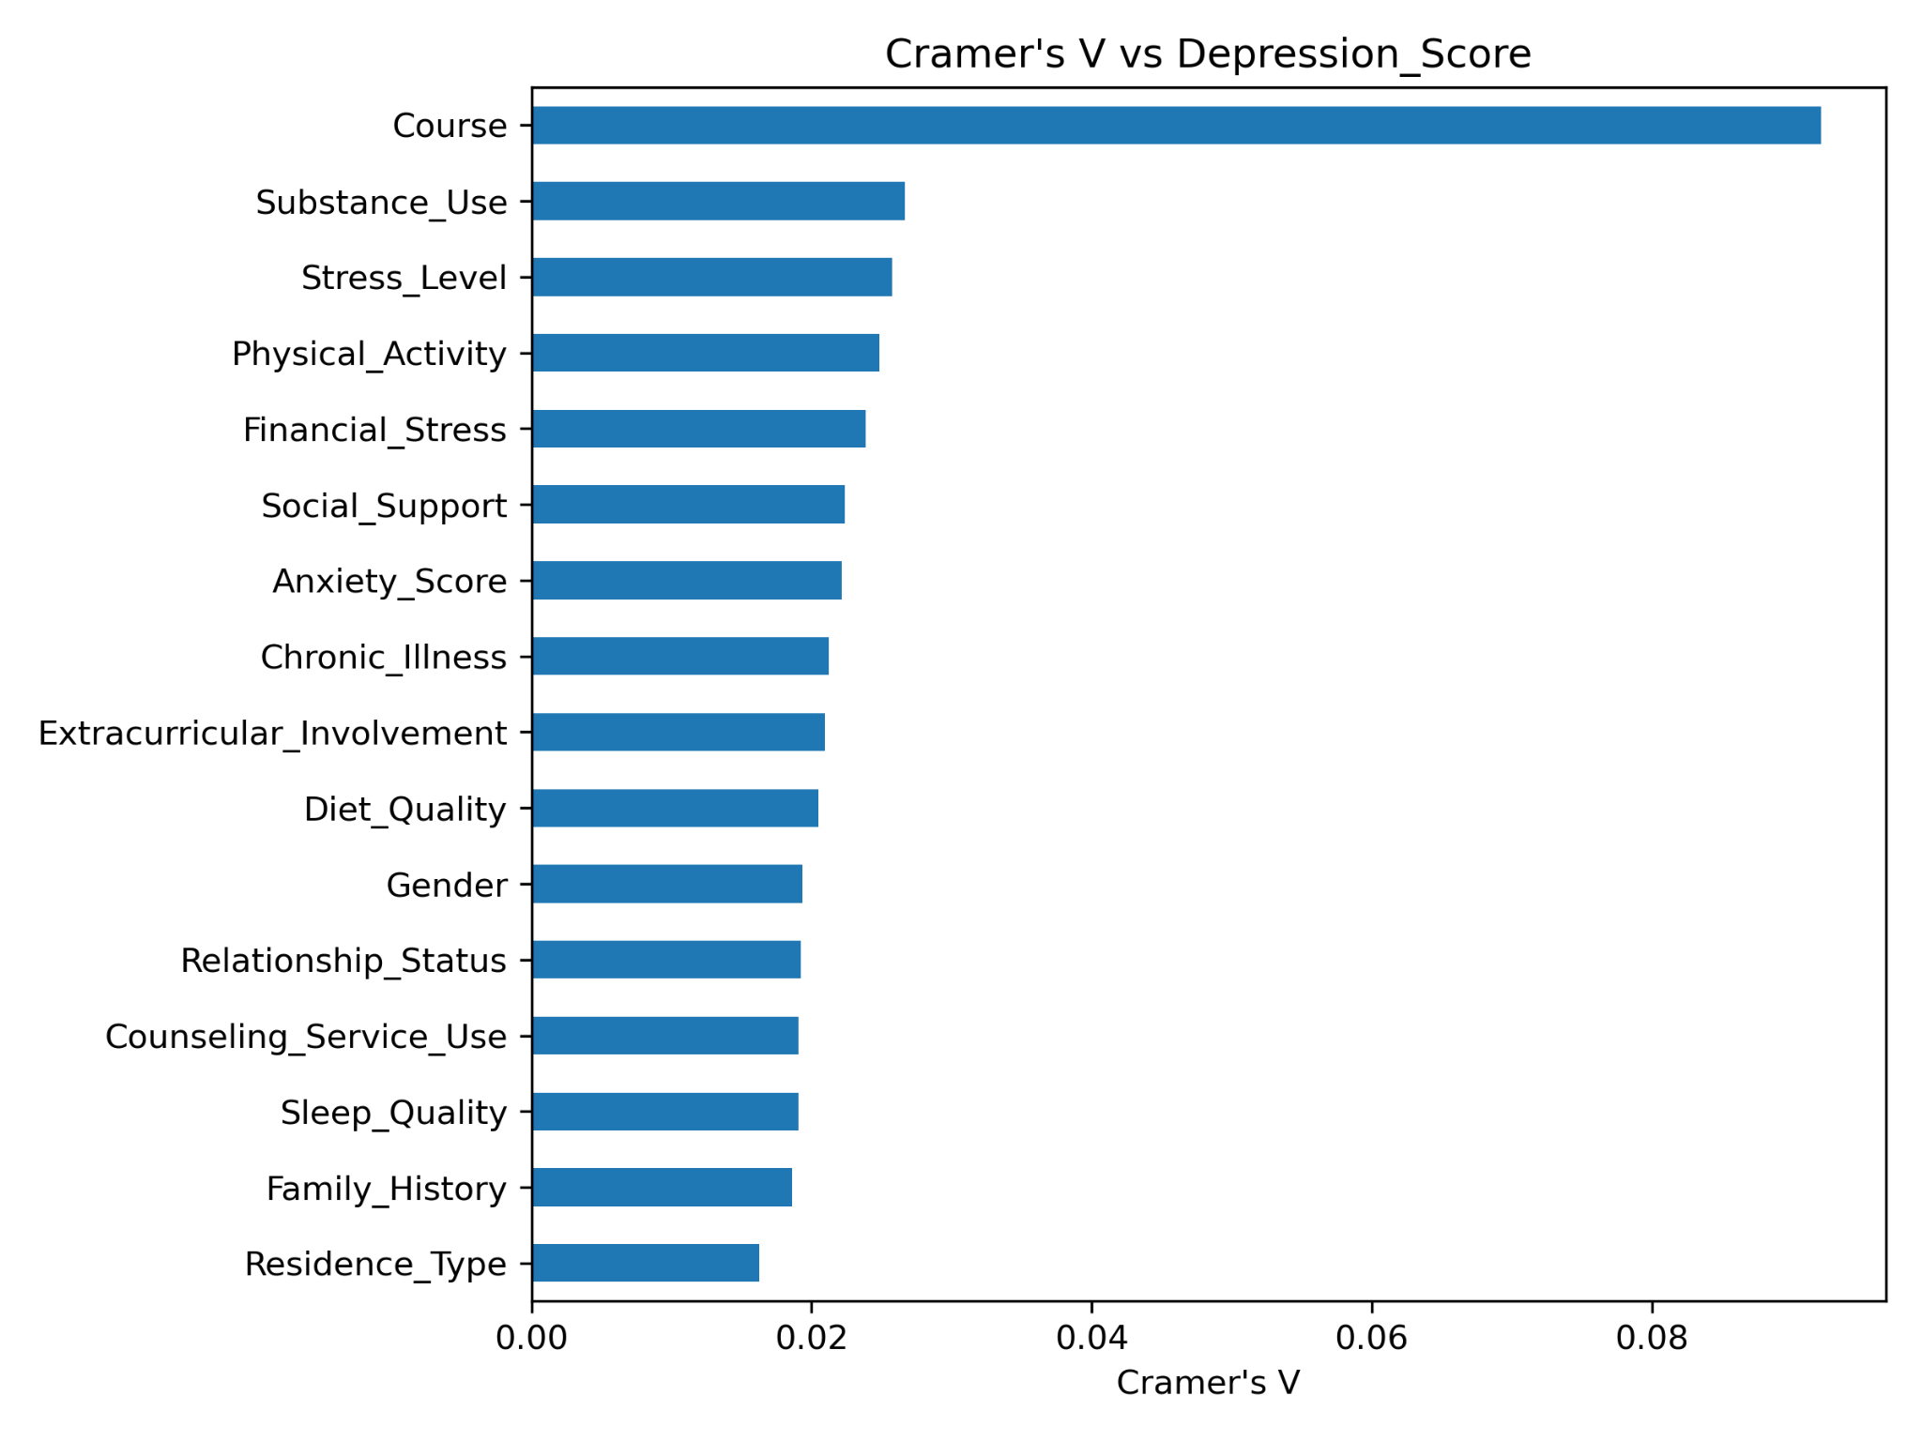
Created Pearson’s correlation matrix and have very low linear correlation among variables (highest is 0.02 for positive correlation and -0.03 for negative correlation).
For association among categorical variables, Cramer's V shows course having the highest association (still very weak) in regards to depression, anxiety and stress level.

Slide 9
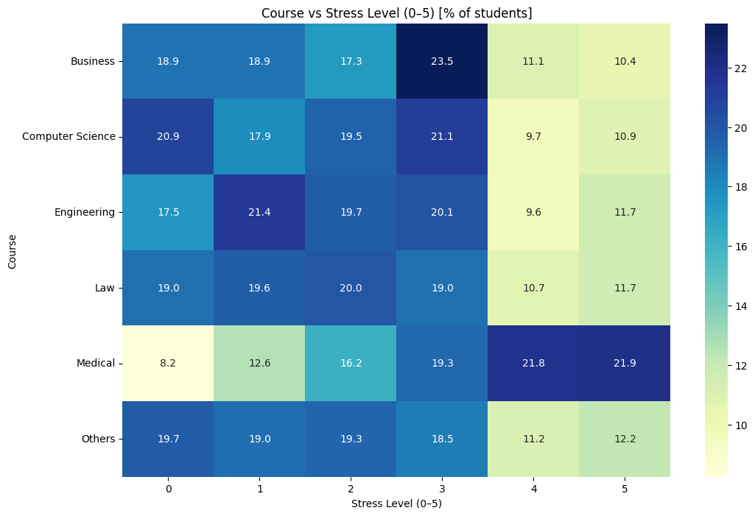
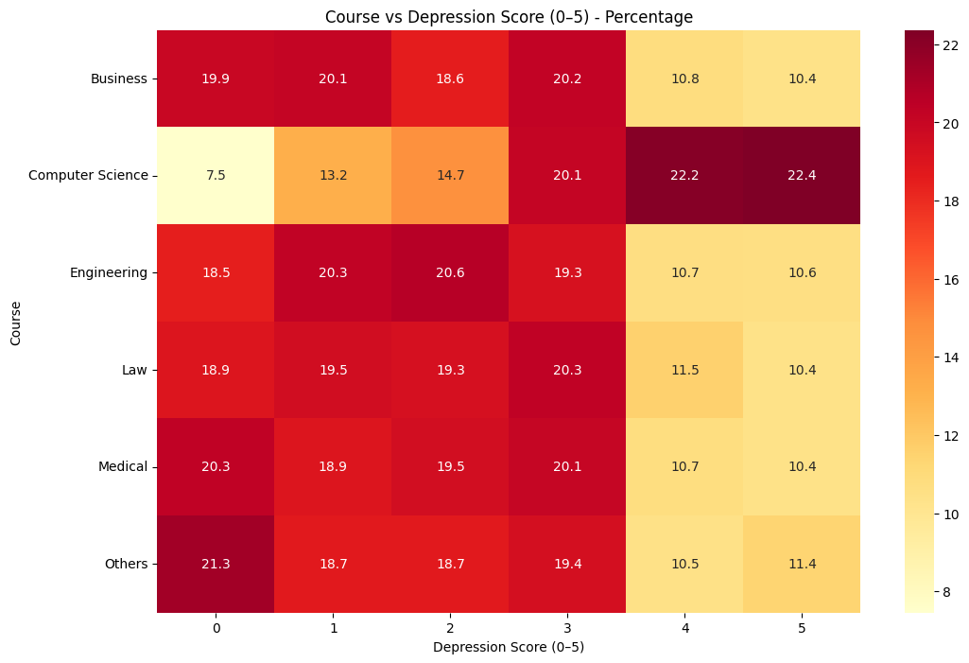
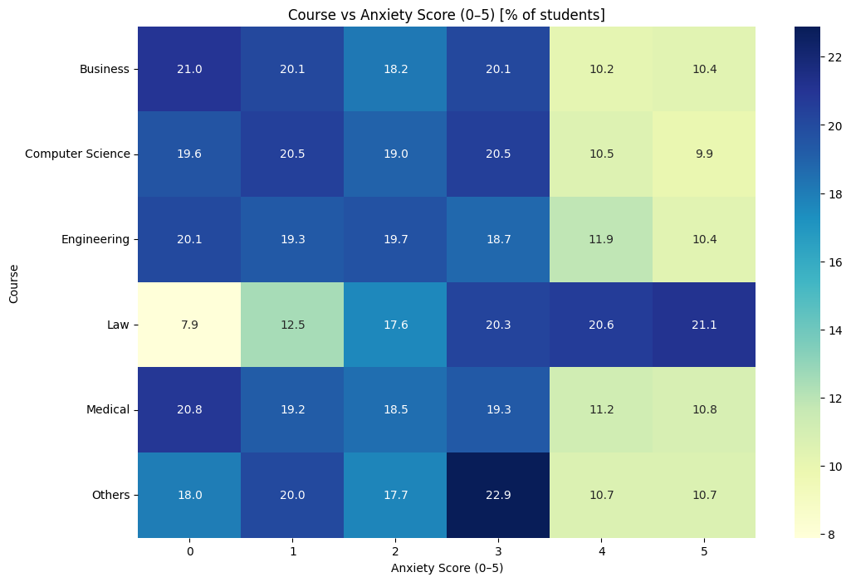
From heatmaps of stress, anxiety and depression
Majority of high depression scores are computer science students
Majority of high stress levels are by medical students
Majority of high anxiety scores are law students

Slide 10
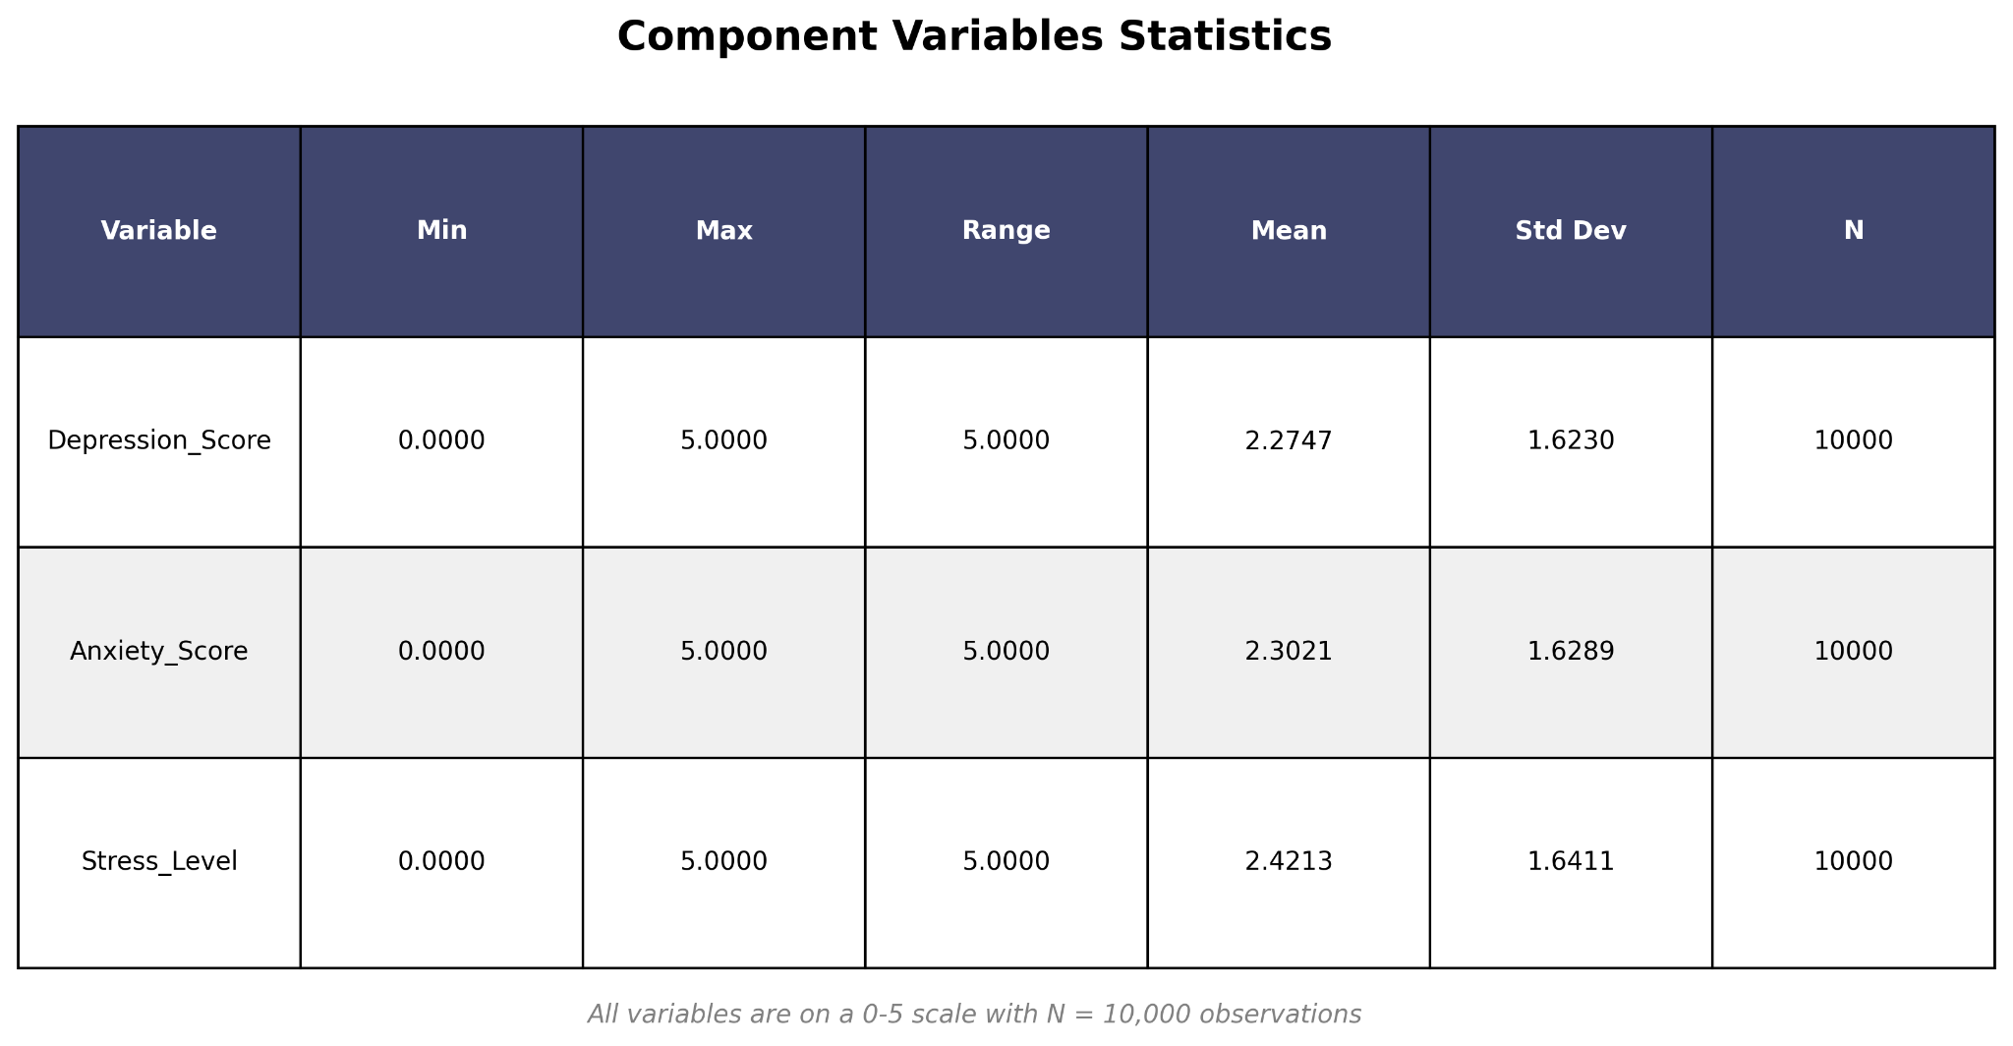
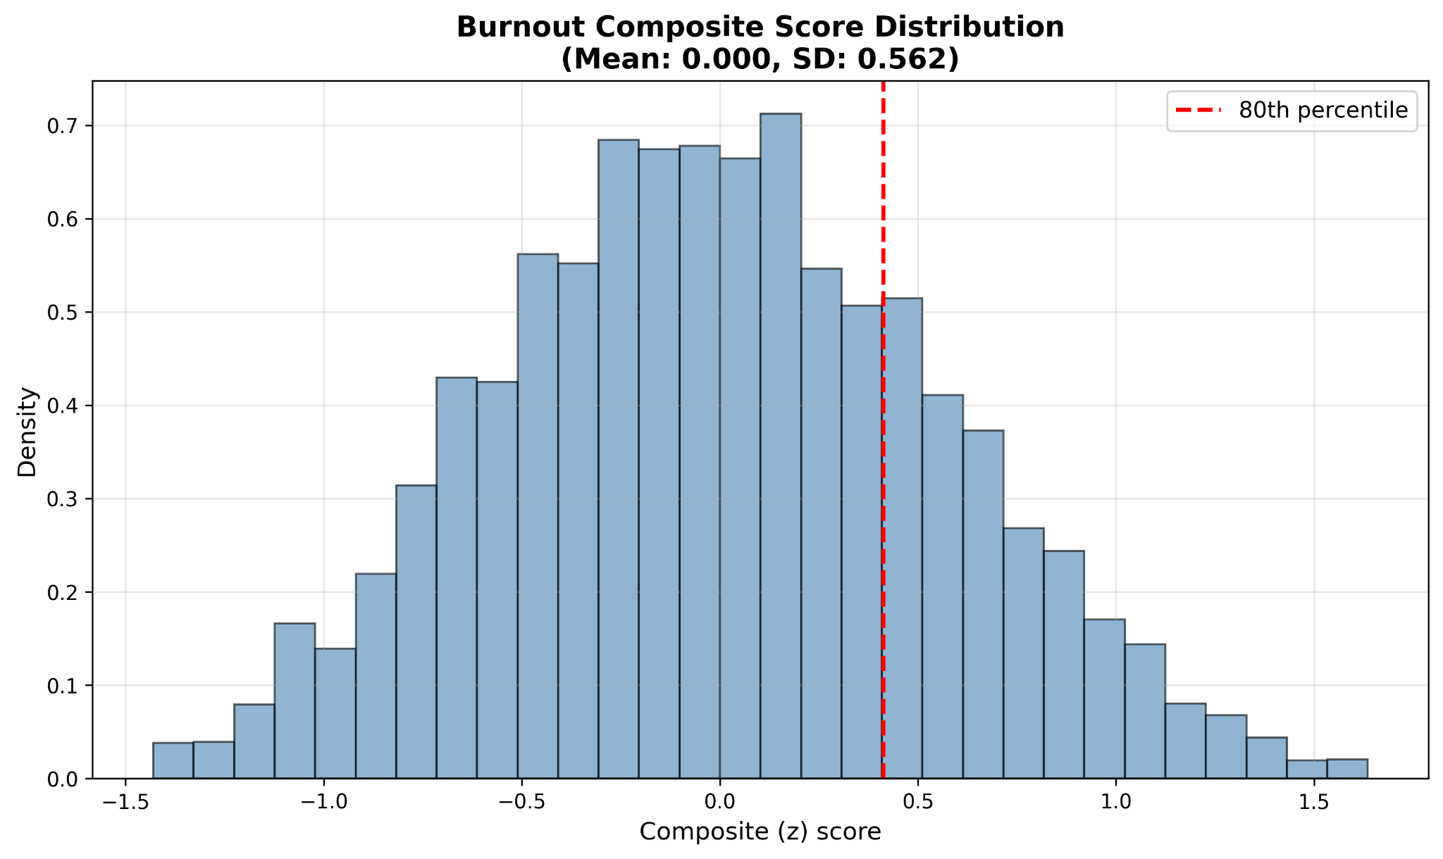
Baseline Model
Logistic Regression
Create a new binary variable, Burnout, which indicates if a student is burnt out or not.
Burnout (1 = Yes, 0=No)
Burnout calculated by using the existing psychological indicators, Stress_Level, Anxiety_Score, and Depression_Score.
By taking z-scores of the mean of our three score variables, we get the standardized burnout scores, where values above the 80th percentile will be classified as either a 1 or 0. Our model will then be used to predict if a student is burnt out or not based on other predictors in our dataset.
Notes:
Ask Ryan what he thinks

Slide 11
Model Candidates
The goal is to predict short-term burnout/stress risk from daily check-ins
Random Forest
Gradient Boosting (XGBoost)
For handling categorical & numeric features
It allows for minimal scaling
Interpretable via feature importances
Excellent accuracy
Supports missing values
Rich in feature importance & SHAP explanations
Small Neural Network
Flexible architecture
Integrated temporal inputs
Easily learns complex feature interactions
Notes:
We’ll compare three non-linear model options: Random Forest for a robust low-friction benchmark; a gradient-boosted model (LightGBM/XGBoost/CatBoost) which I think is our likely top performer; and a small neural network if we need to include any temporal patterns or embeddings. Each model will be evaluated with cross-validation using PR-AUC, and we’ll use try to use SHAP to keep the outputs explainable.

Slide 12
Future Applications
Help students find resources for mental health support.
Provide resources for emotional/mental support.
Connect students who could be facing similar struggles.

Slide 13

Week 1
Week 2
Week 3, 4
Week 5,6
02/17-02/23
02/24-03/02
03/03-03/16
03/17-03/ 27
Data and EDA
> Lock down dataset
> EDA analysis done by every member and shared insights
> Plan EDA insights to feature engineering
Database setup and Train baseline model
> Design Features of model
Framework
> Setup Supabase Project
> Engineer Baseline model
> Set up Github repository
> Pitch presentation
SUPERVISED ML
> Train Logistic Regression (baseline)
> Train Random Forest (main)
> Evaluate: Accuracy, F1-score, confusion matrix
> Extract feature importance
SUPERVISED ML
> Train Gradient
boosting
>Train on Neural Networks architecture
> Evaluate: Accuracy, F1-score, confusion matrix
Week 7
Week 8
Week 9
Week 10
04/08-04/14
04/15-04/21
04/22-04/28
04/29-05/05
BACKEND
> Build auth routes (signup, verify-otp, login)
> Add user profile dashboard
> Database integration (Supabase)
> ML Model training in continuation
FRONTEND (UI/UX)
> Build chat interface
> Create dashboard (gauge, factors, trends)
> Responsive design
> Polish UX & animations
> Review ML Models
OPENAI & INTEGRATION
> Integrate OpenAI API
> Implement caching (save costs)
> End-to-end testing (full flow)
> UAT with 10-20 real users
> Gather feedback on predictions & tips
LAUNCH & DOCUMENTATION
>Deploy on Streamlit
> Present final project
> Share GitHub repo
> Report Creation

Slide 14
GITHUB: LINK

Slide 15
Thank You!
Stay Tuned!

